Slide 1



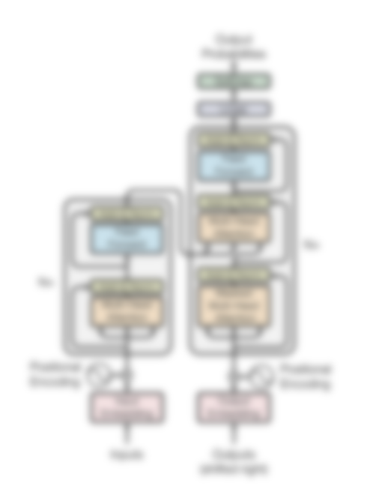







Transformers
and
Diffusion

Slide 2
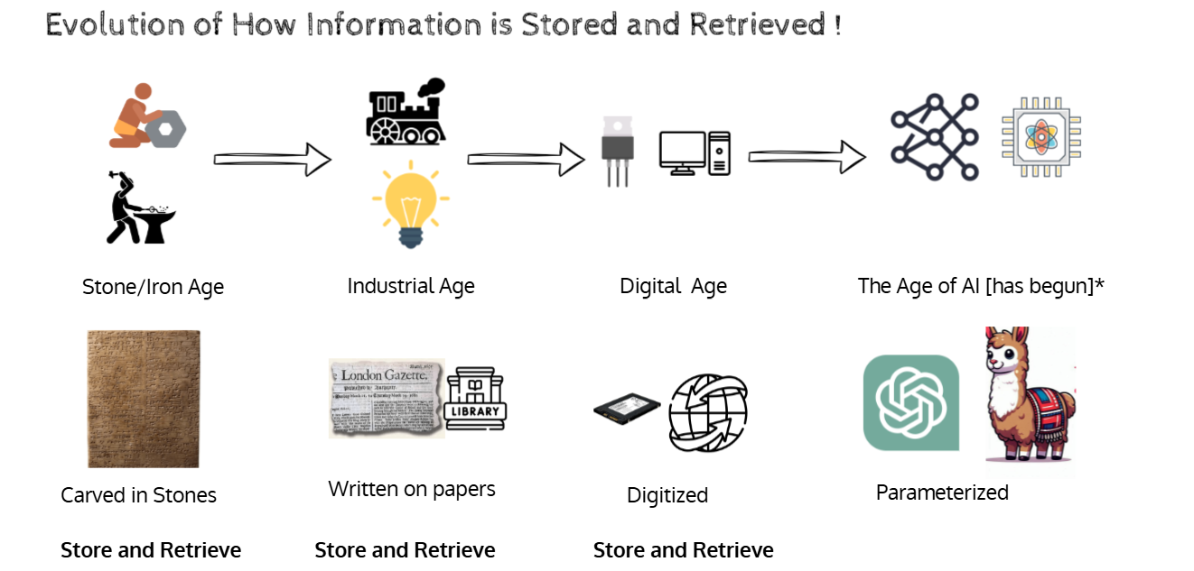

Slide 3
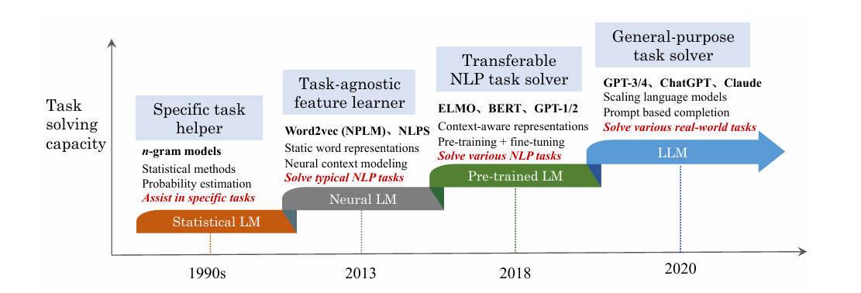
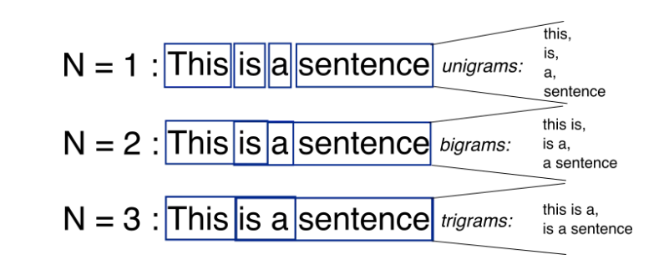
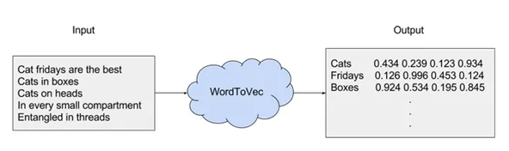

Slide 4
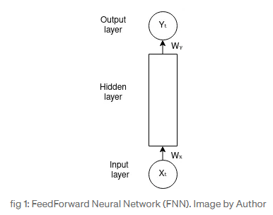
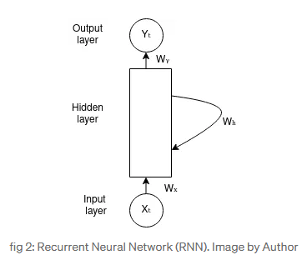
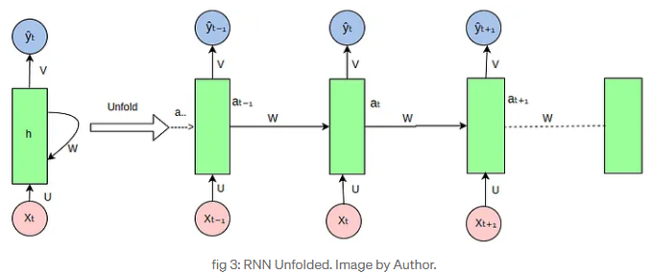
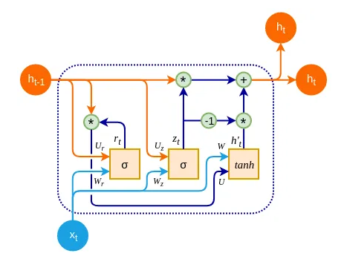

Slide 5
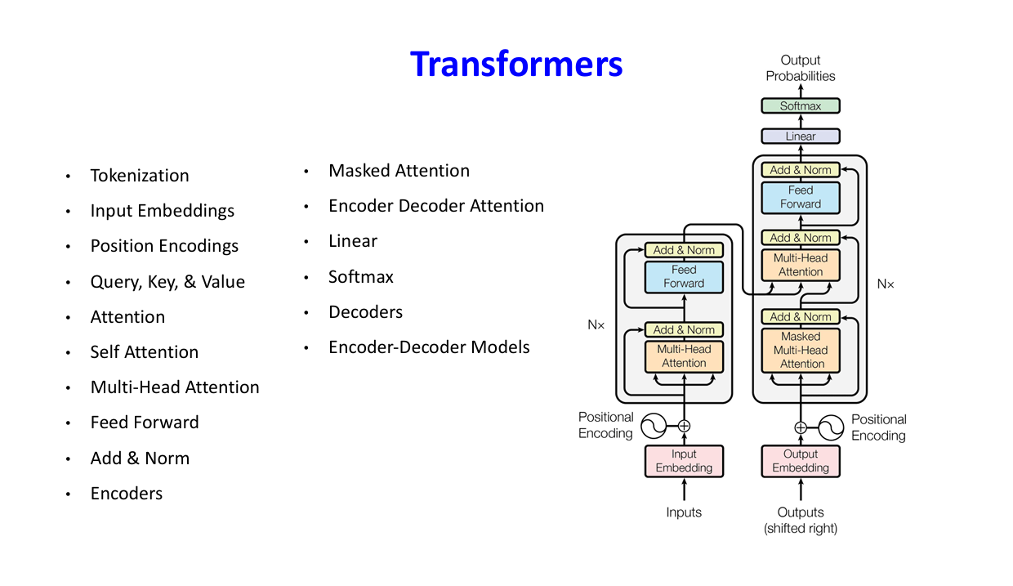

Slide 6
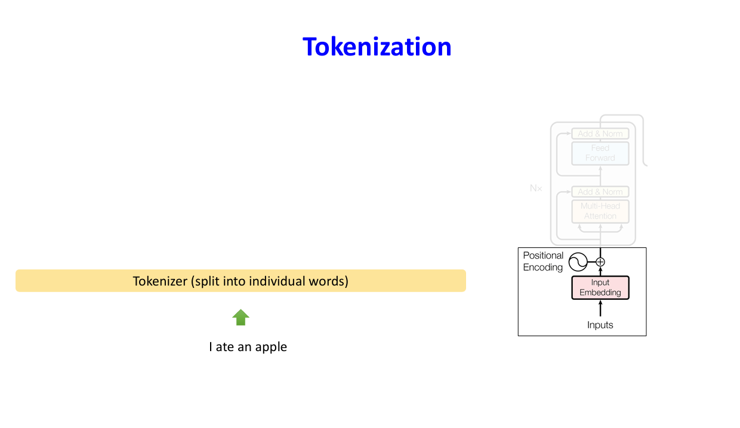

Slide 7
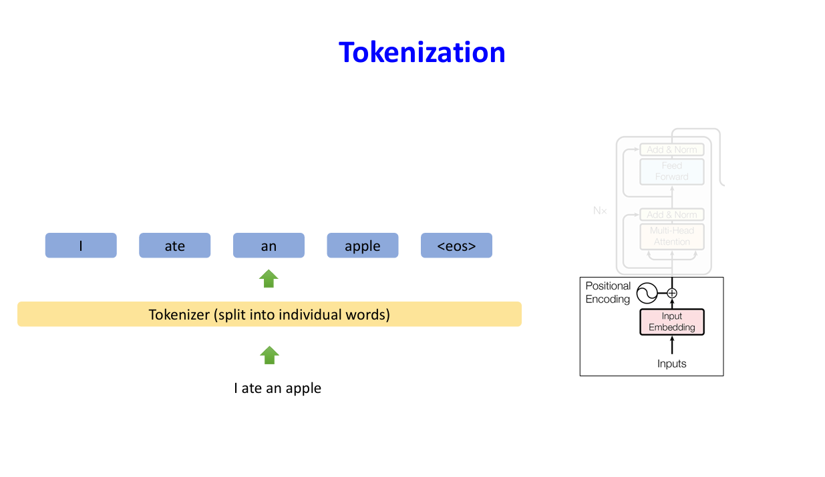

Slide 8
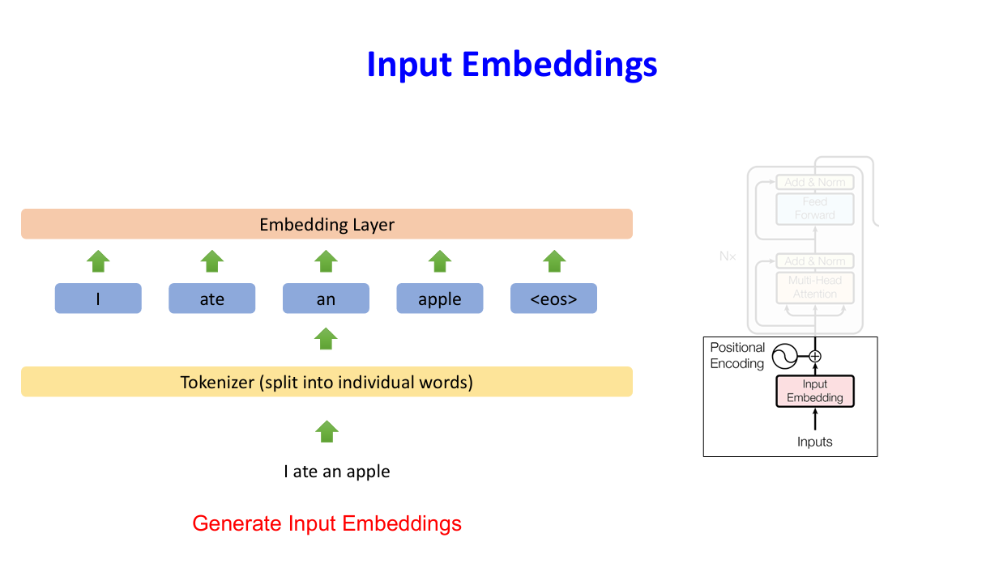

Slide 9
Tokenization
Tiktokenizer
https://huggingface.co/spaces/Xenova/the-tokenizer-playground
Vector Embeddings - GloVe
Embedding projector - visualization of high-dimensional data

Slide 10
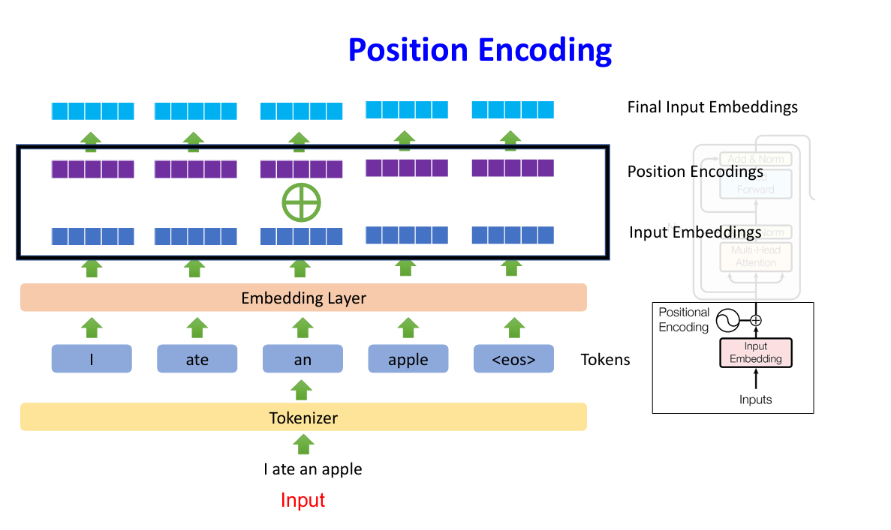

Slide 11
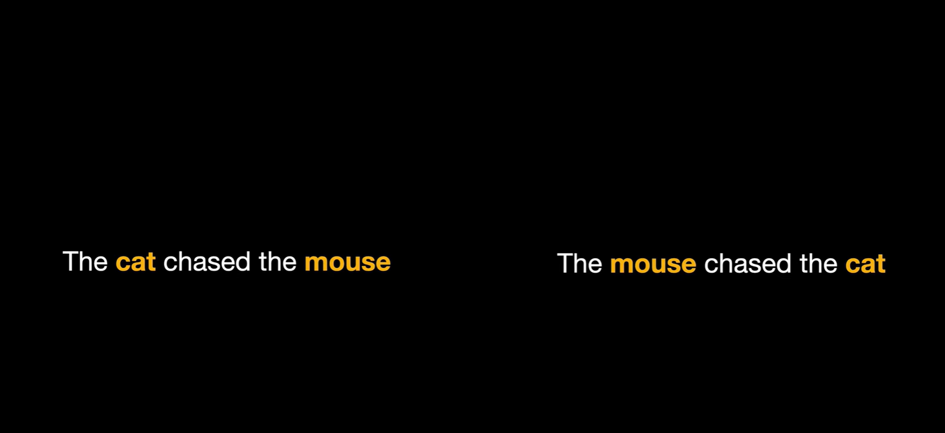

Slide 12
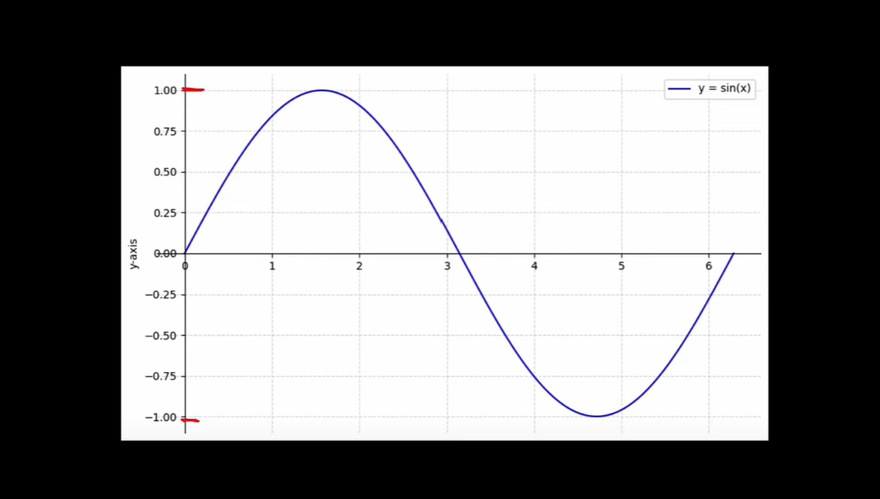

Slide 13
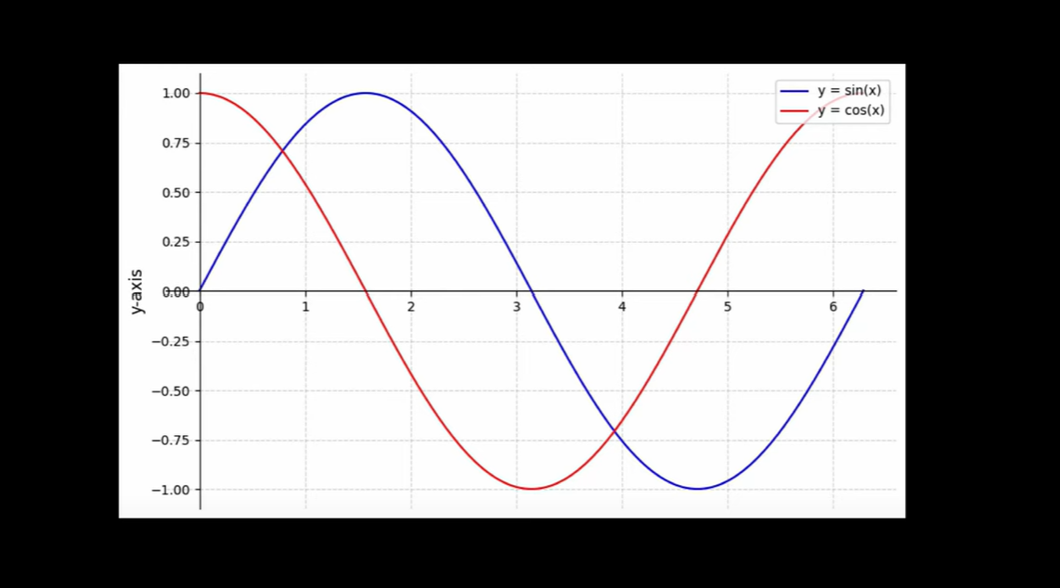

Slide 14
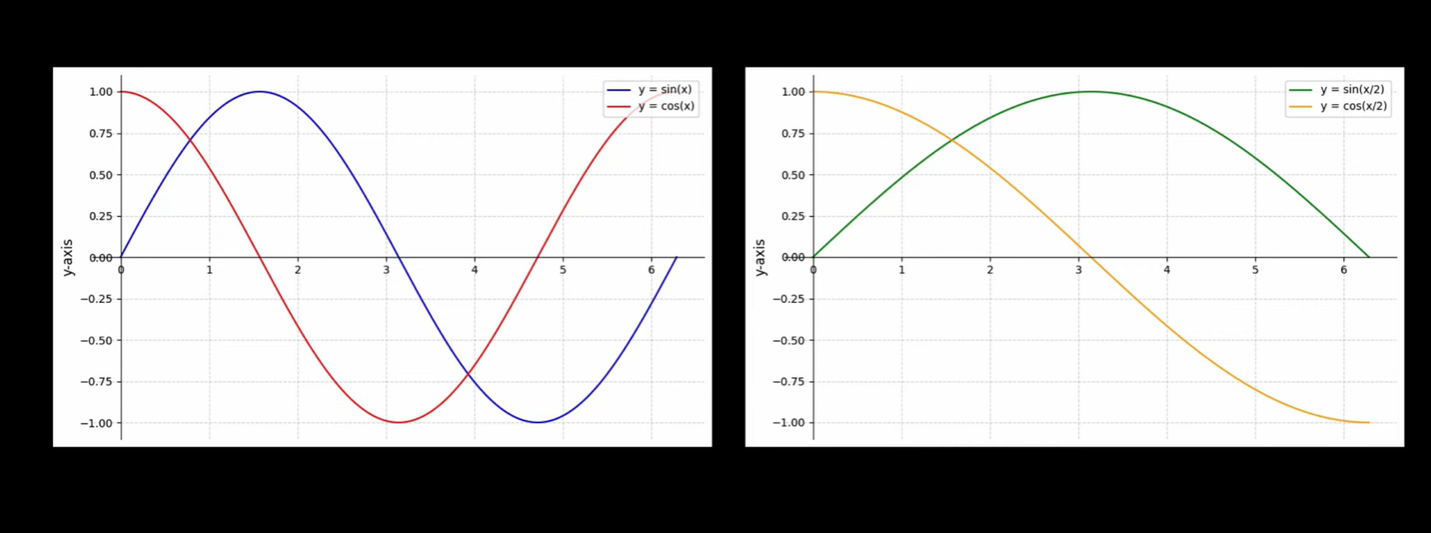

Slide 15
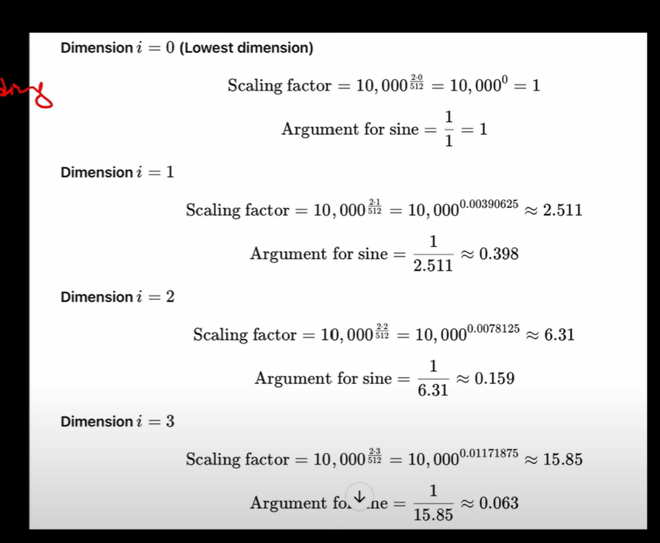
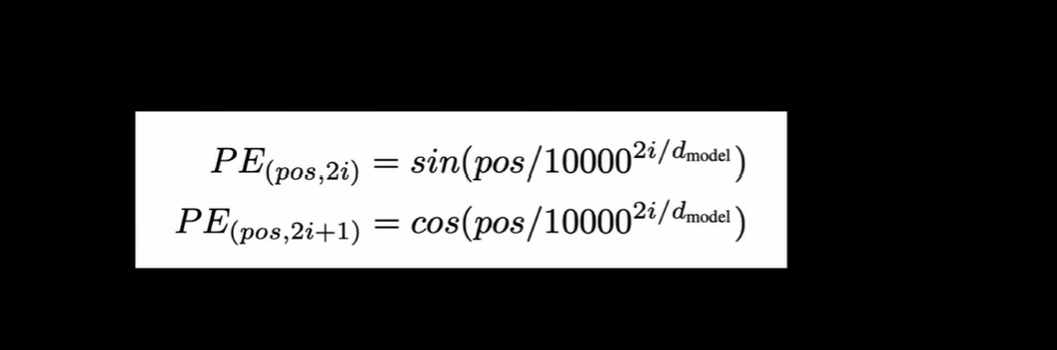

Slide 16
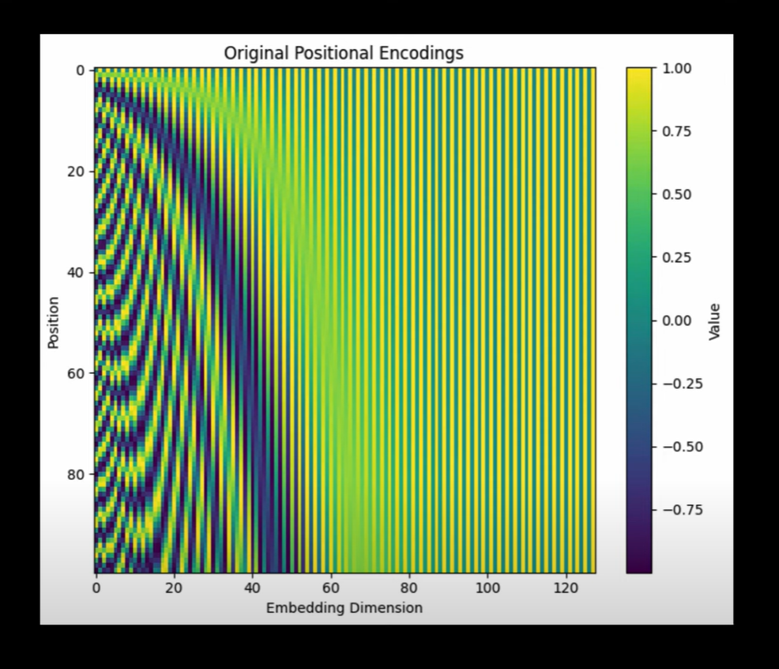

Slide 17
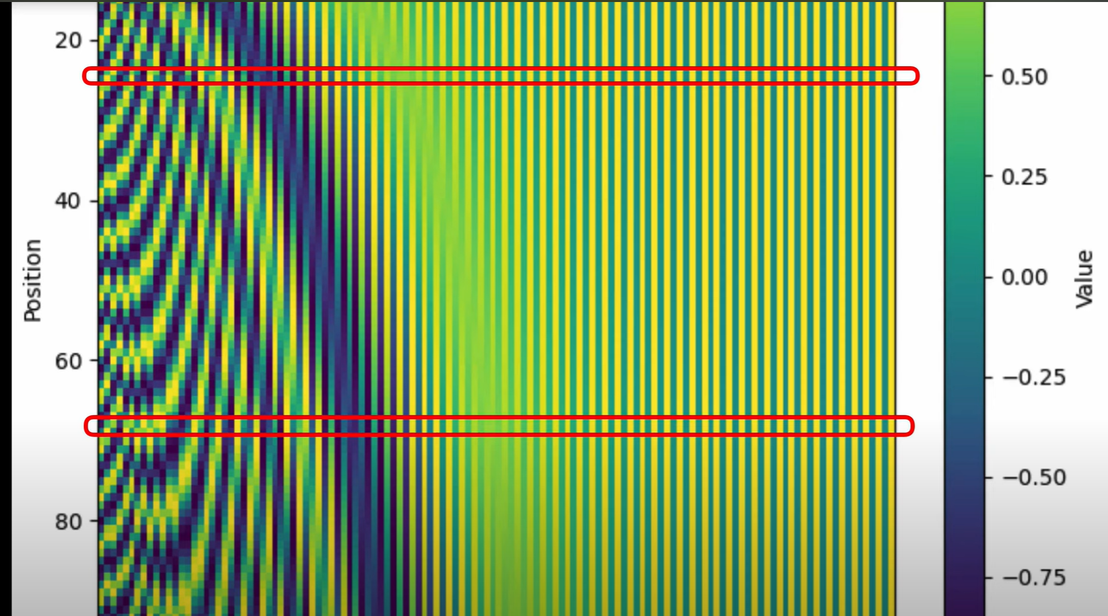

Slide 18
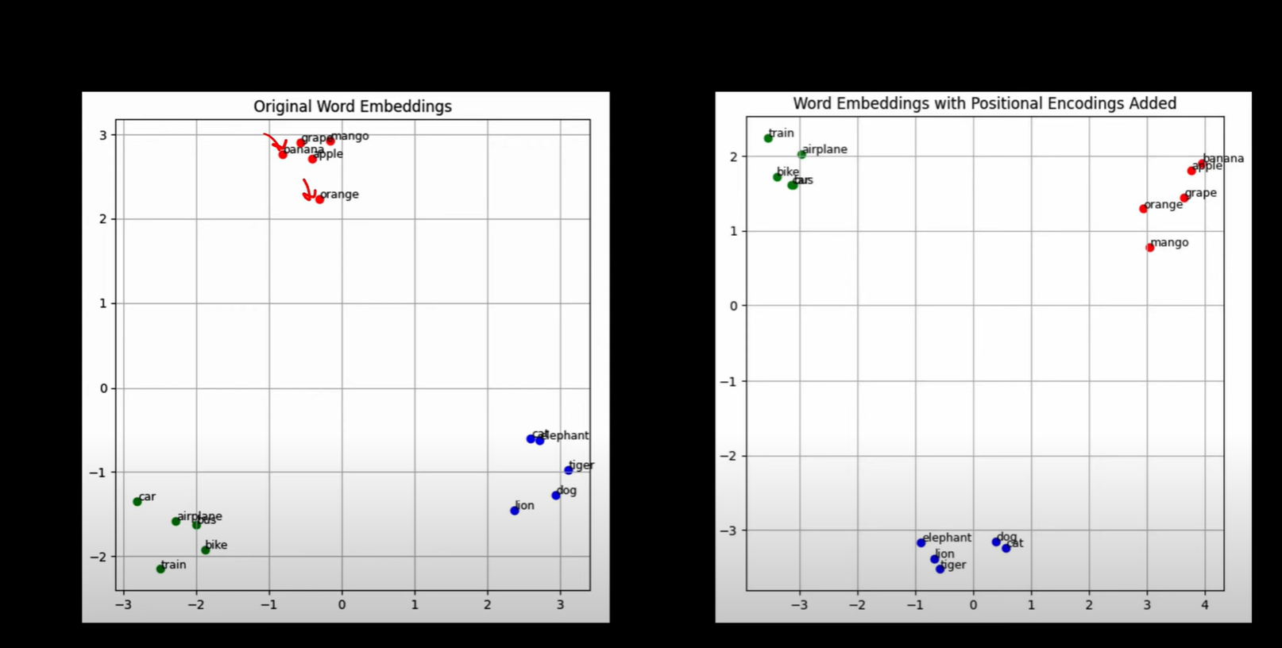

Slide 19
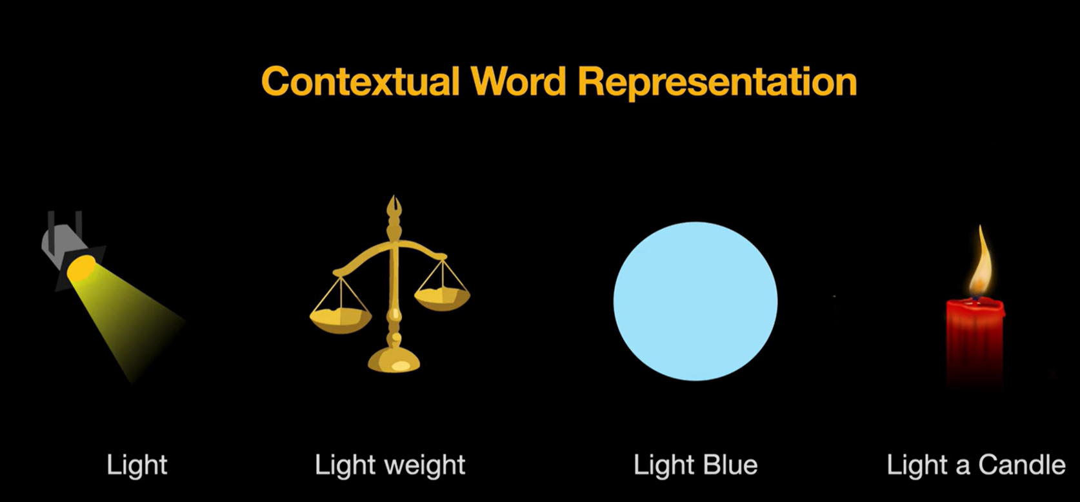

Slide 20
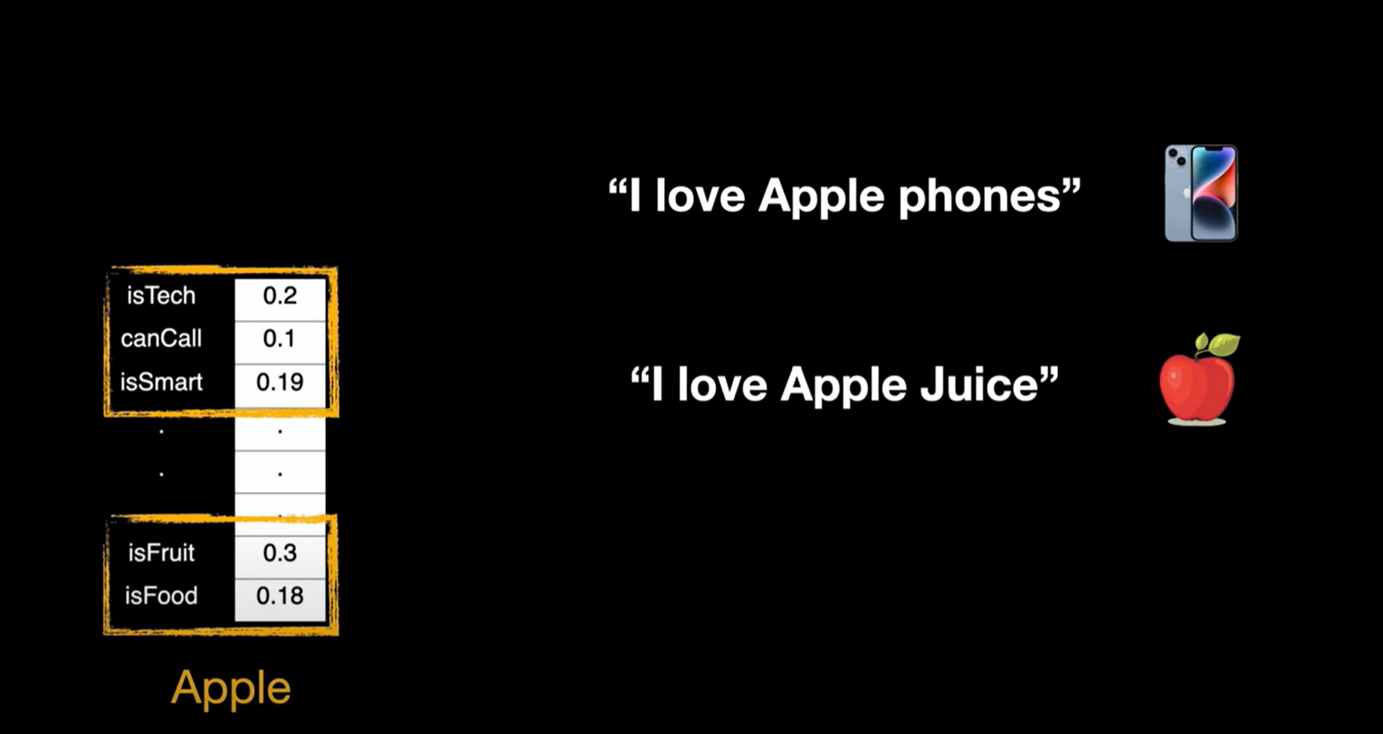

Slide 21
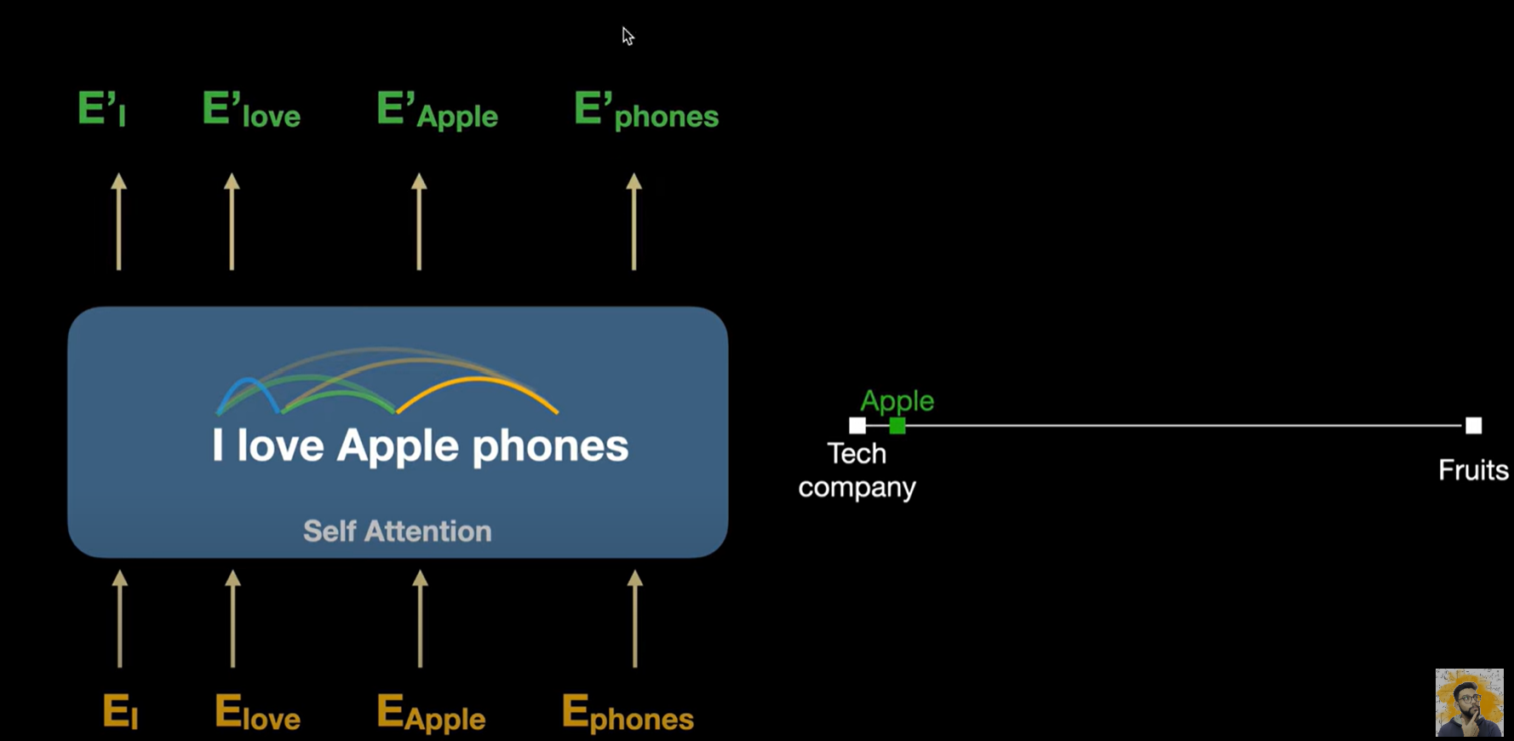

Slide 22
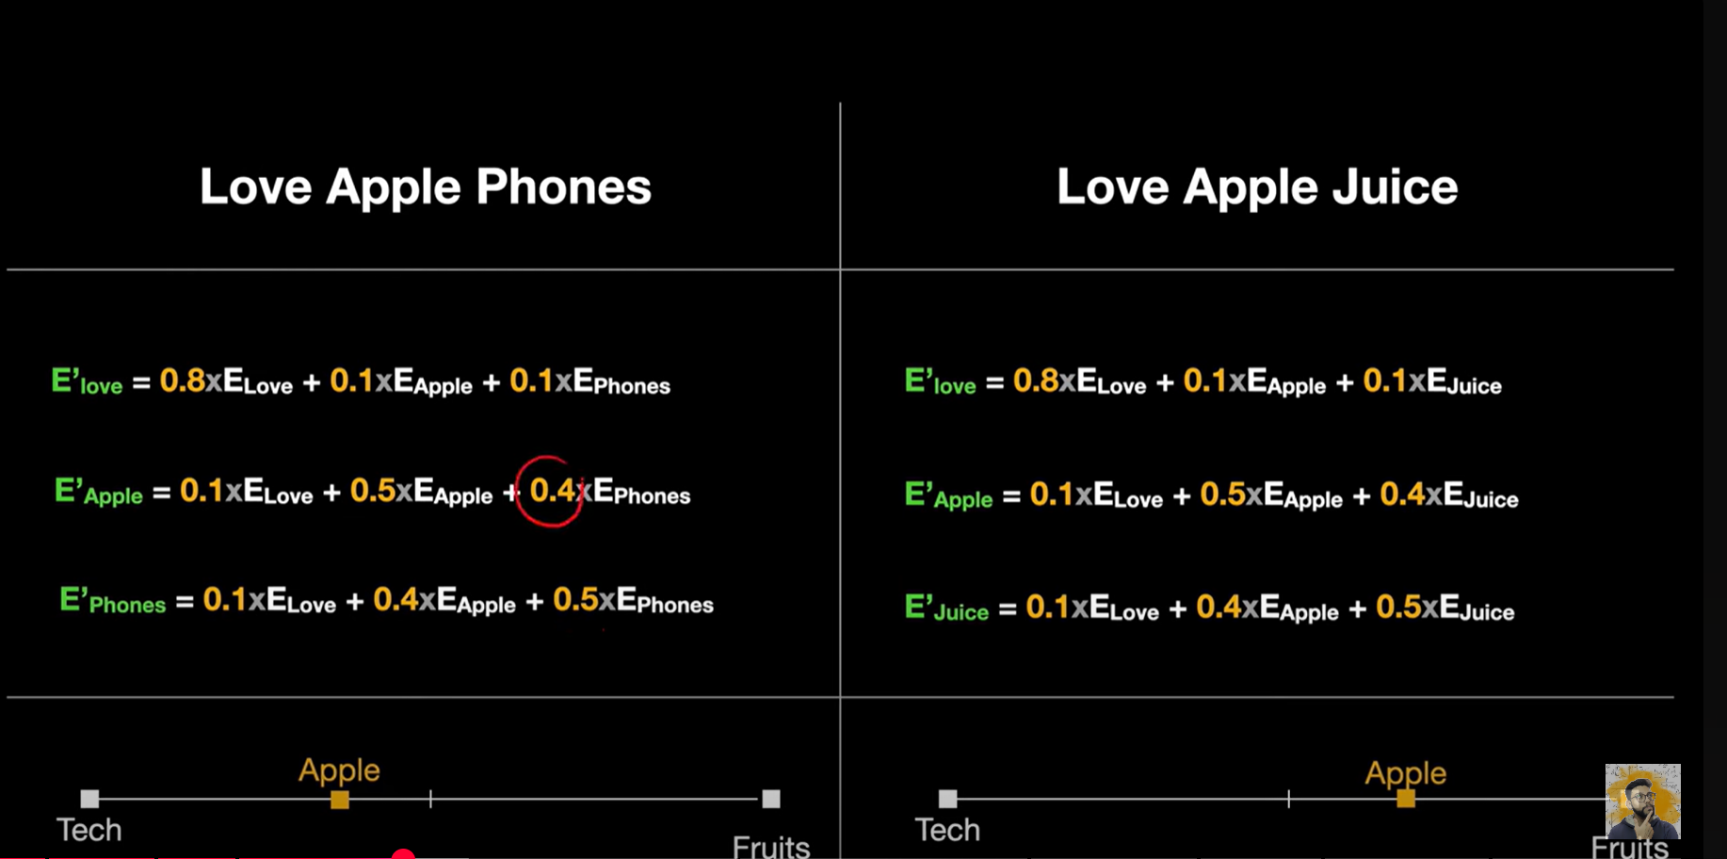

Slide 23
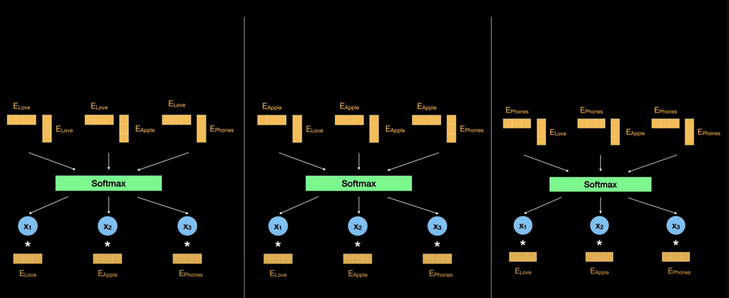

Slide 24
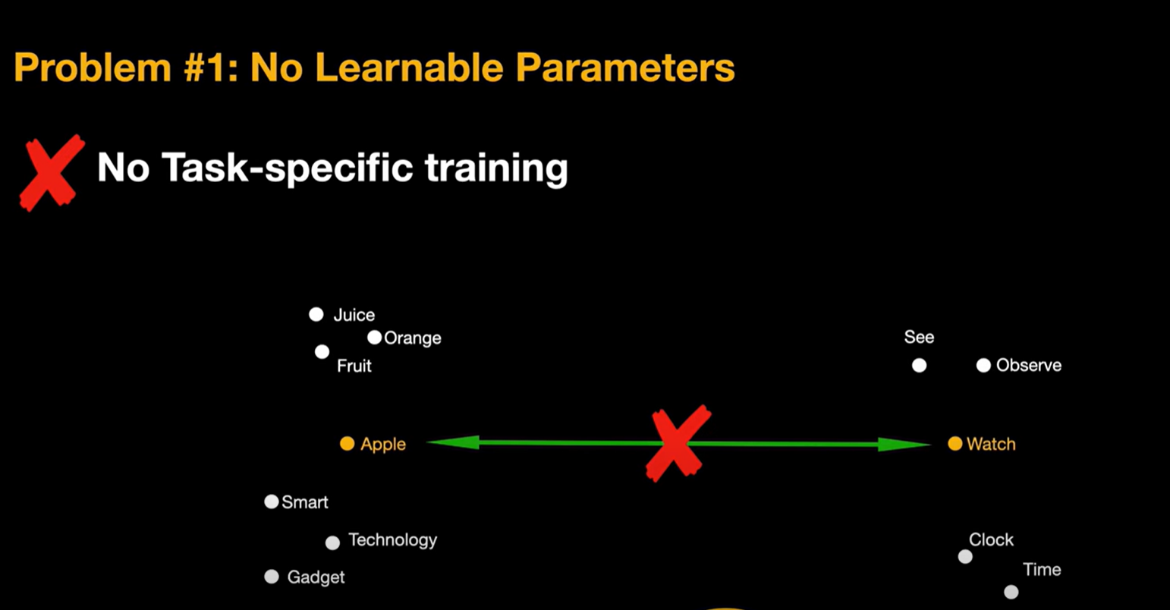

Slide 25
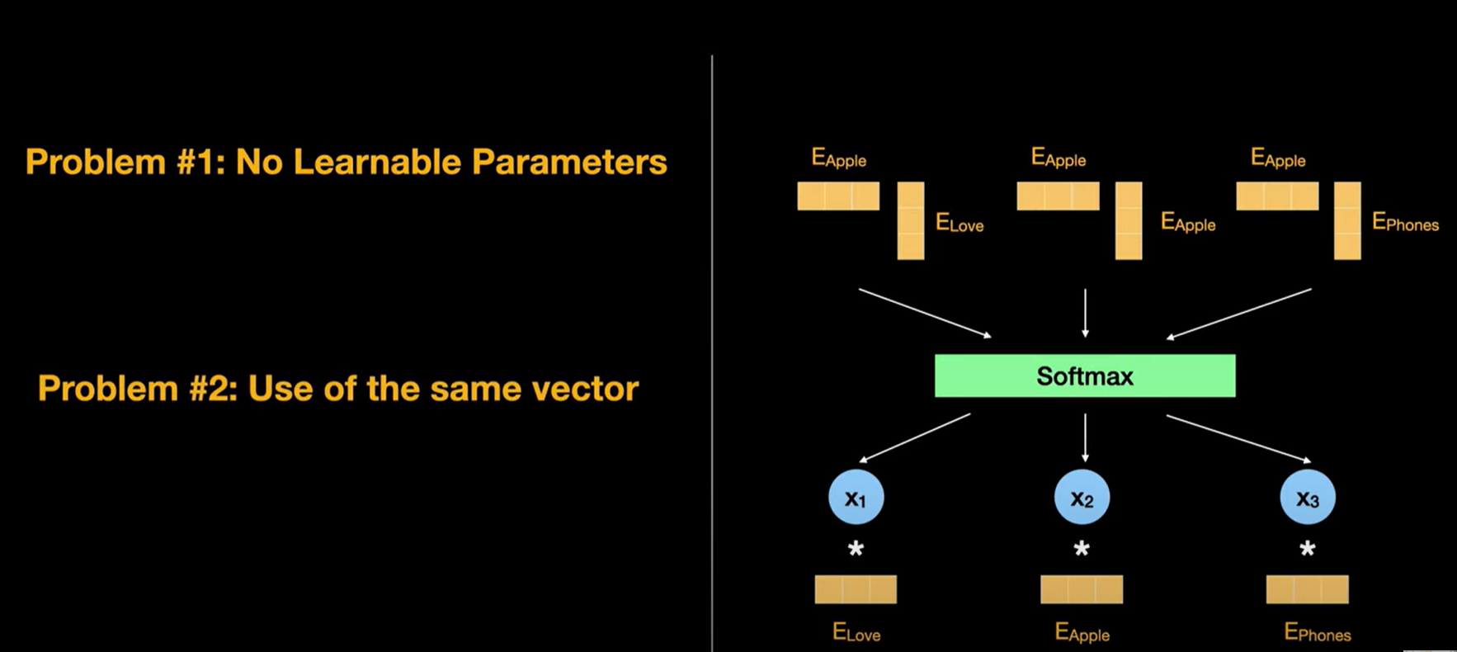

Slide 26
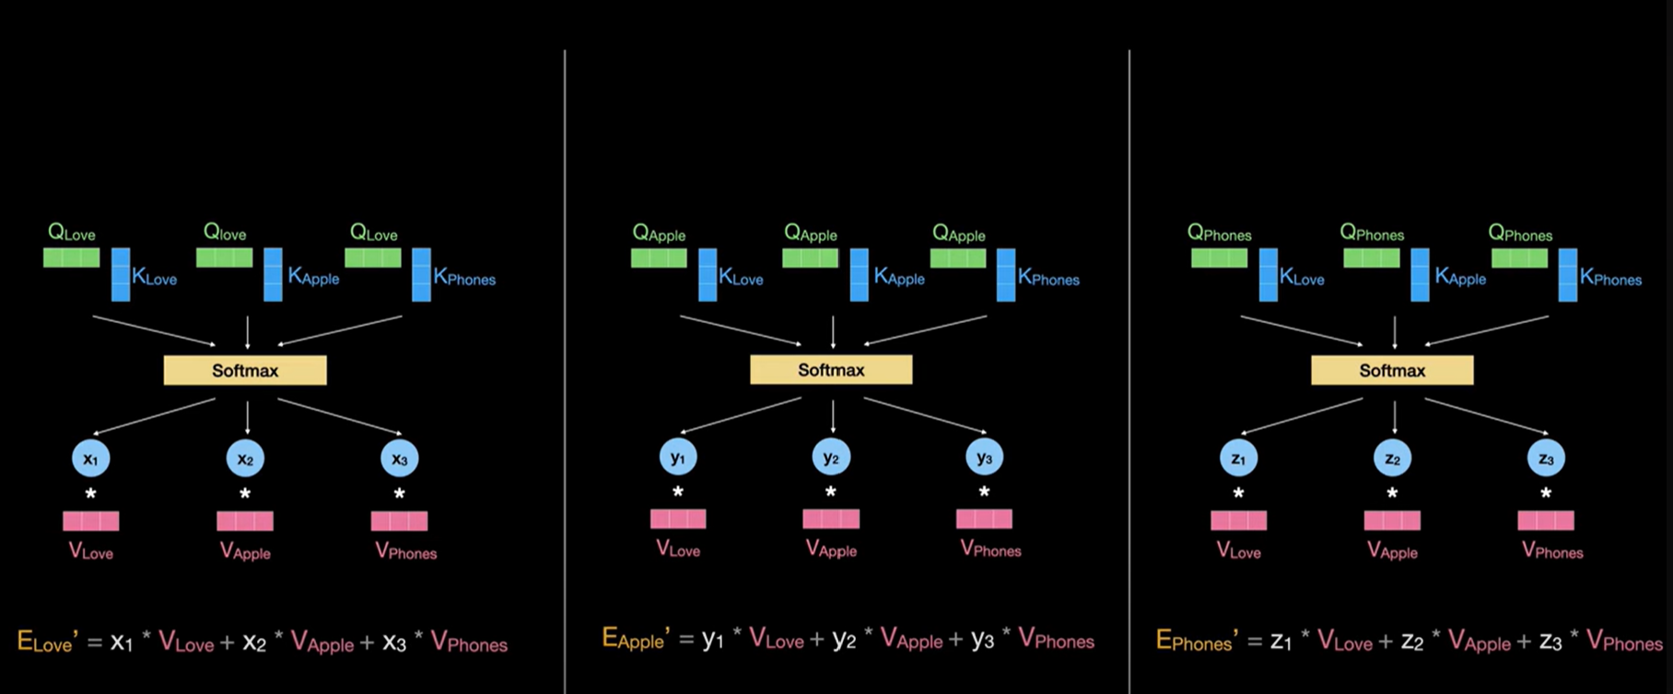

Slide 27
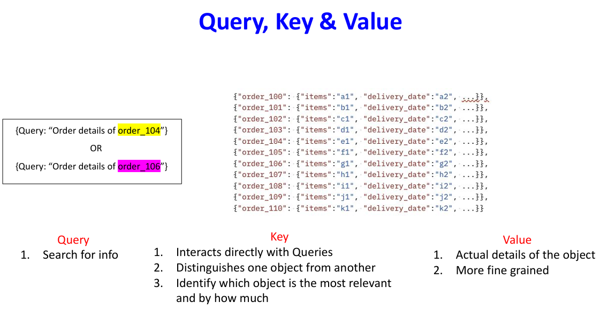

Slide 28
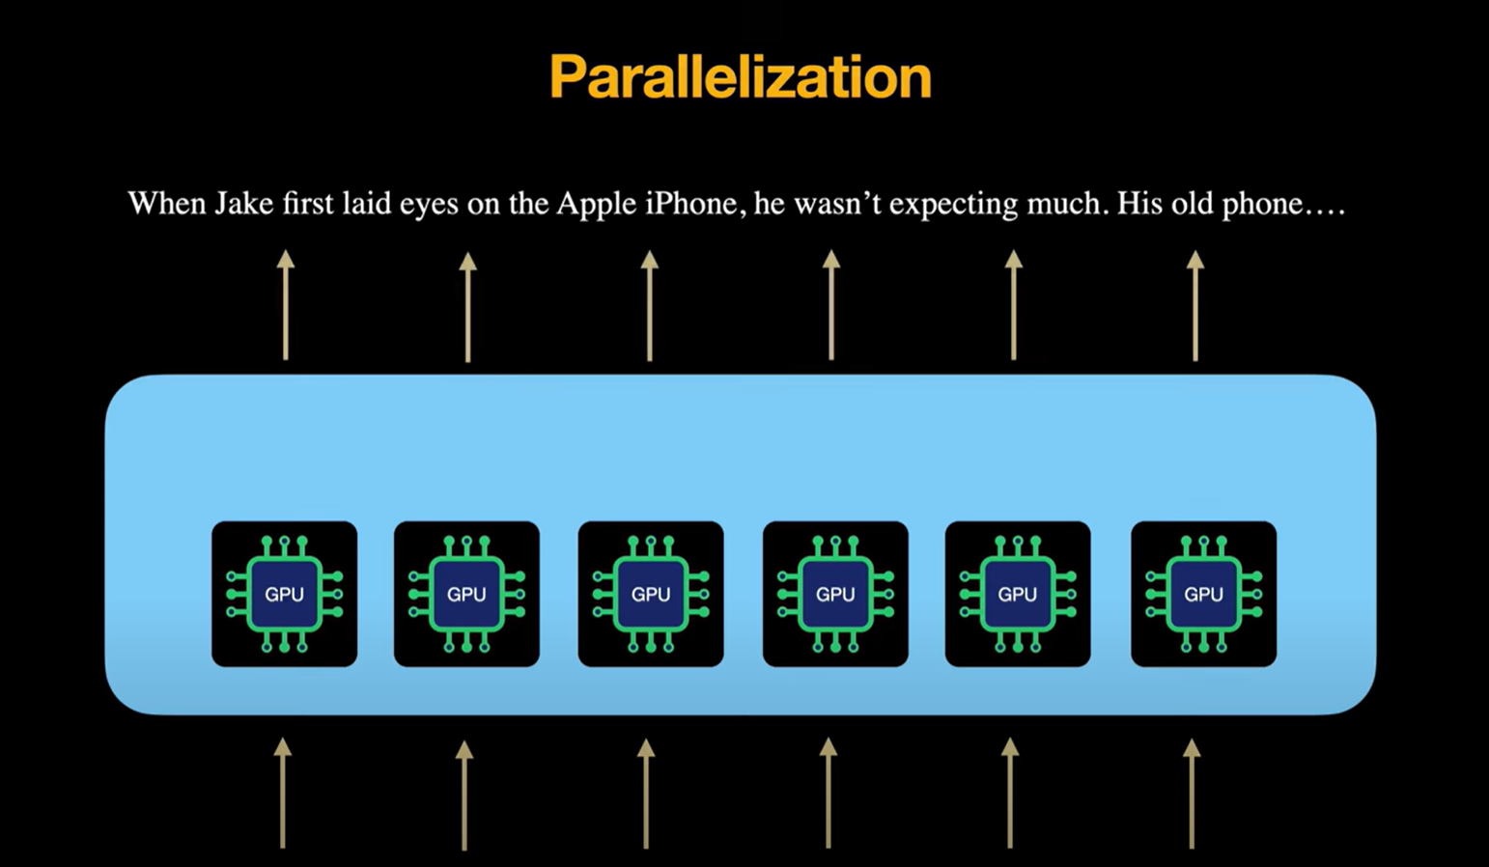

Slide 29
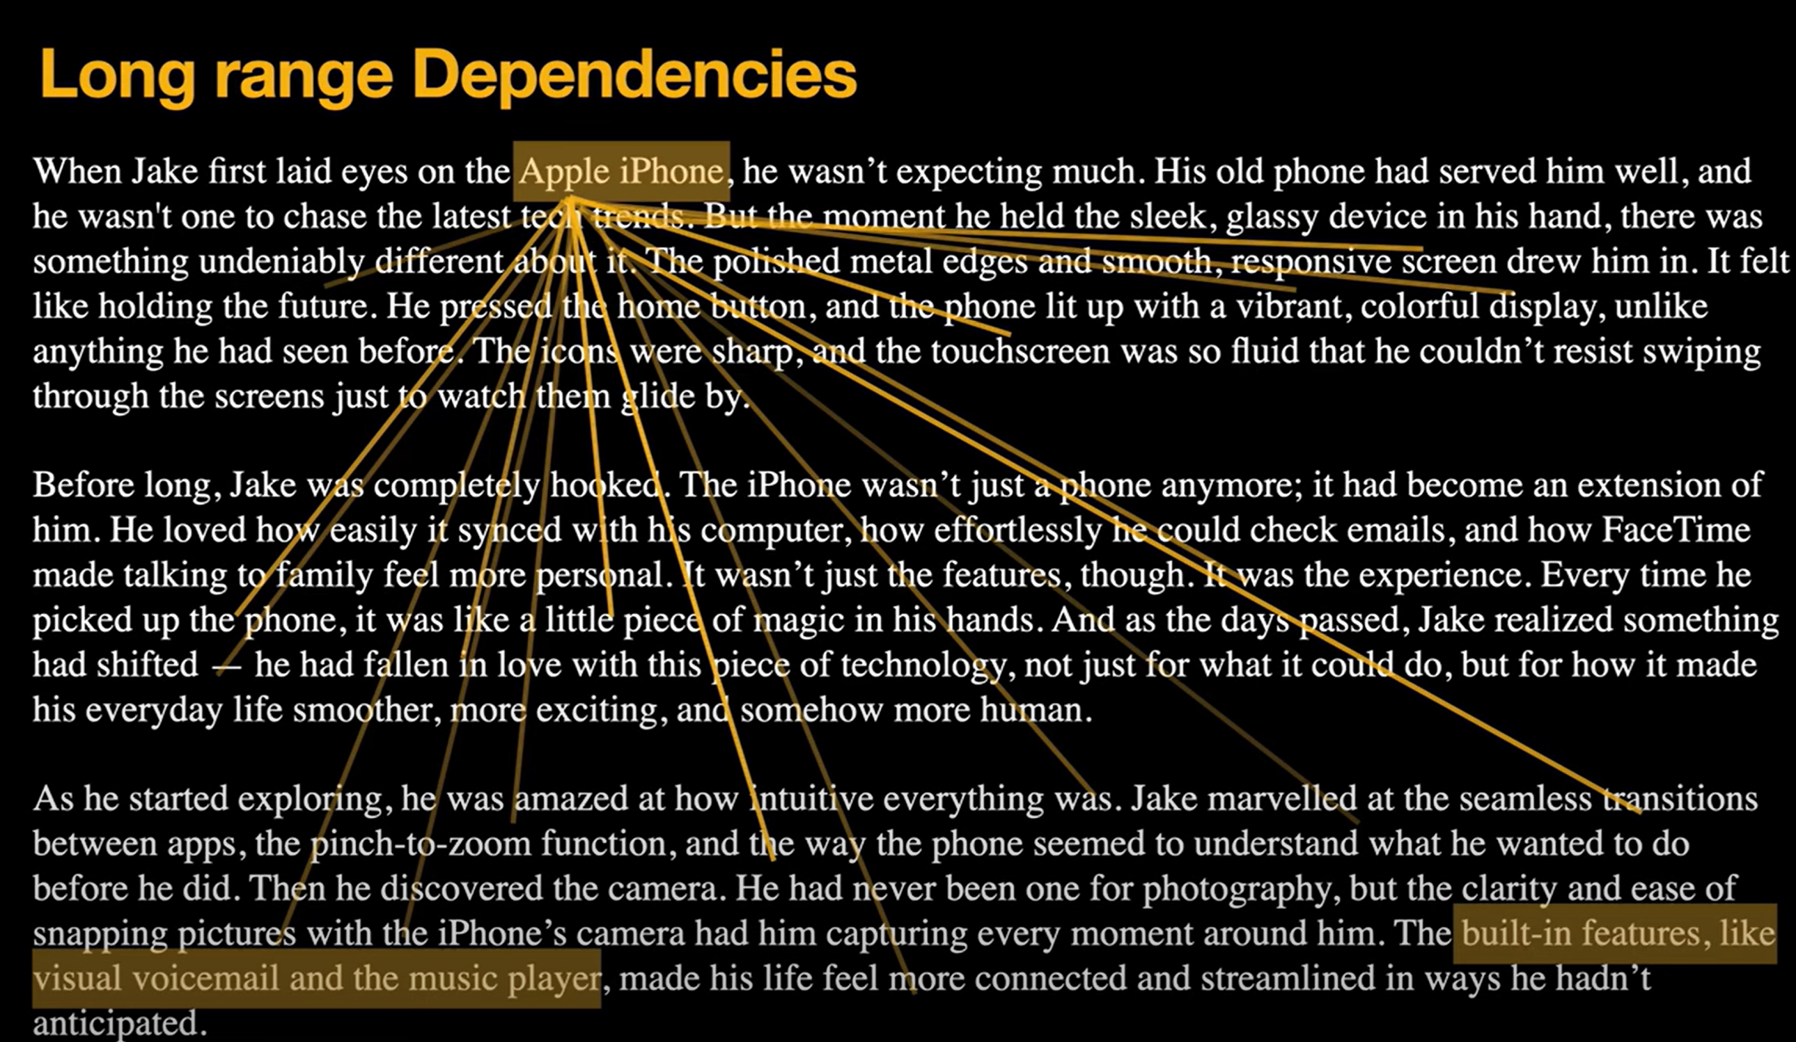

Slide 30
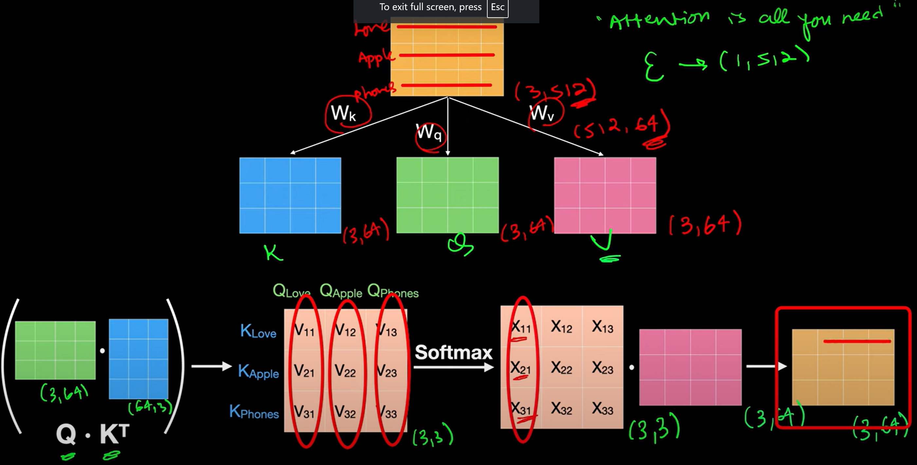

Slide 31
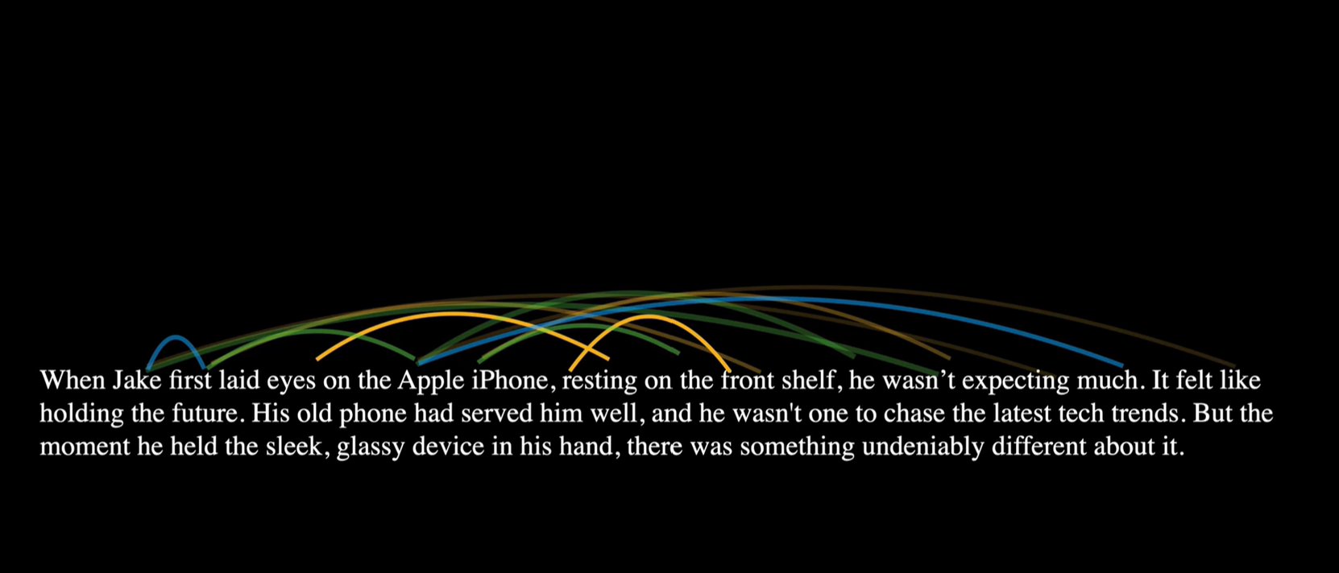

Slide 32
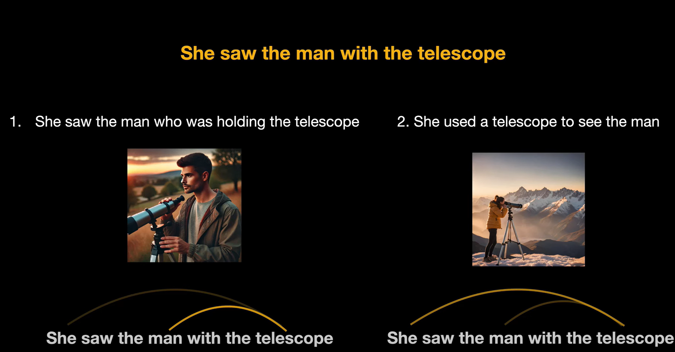

Slide 33
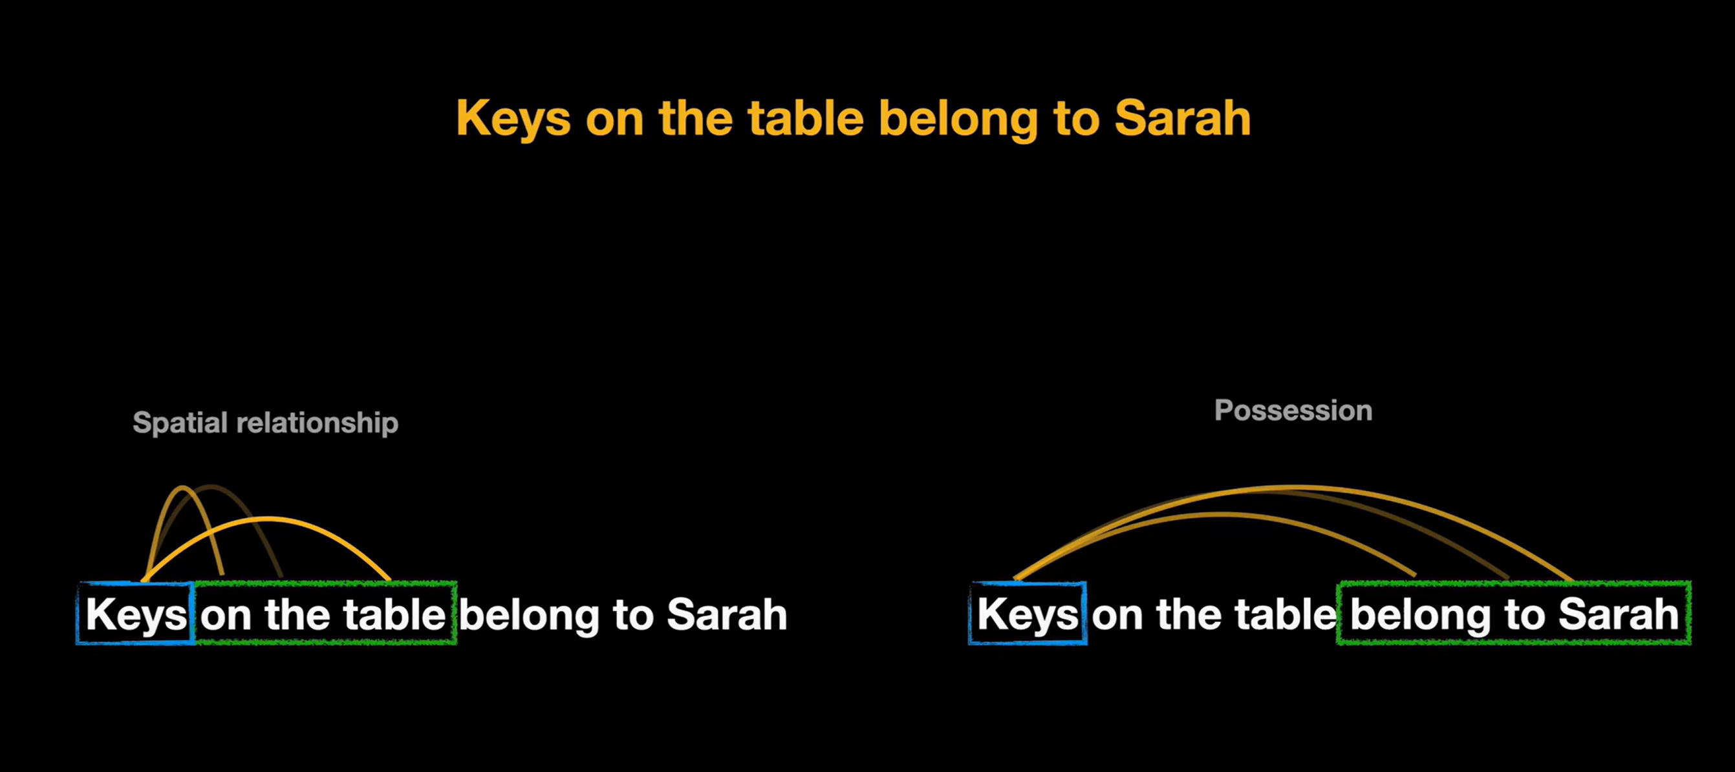

Slide 34
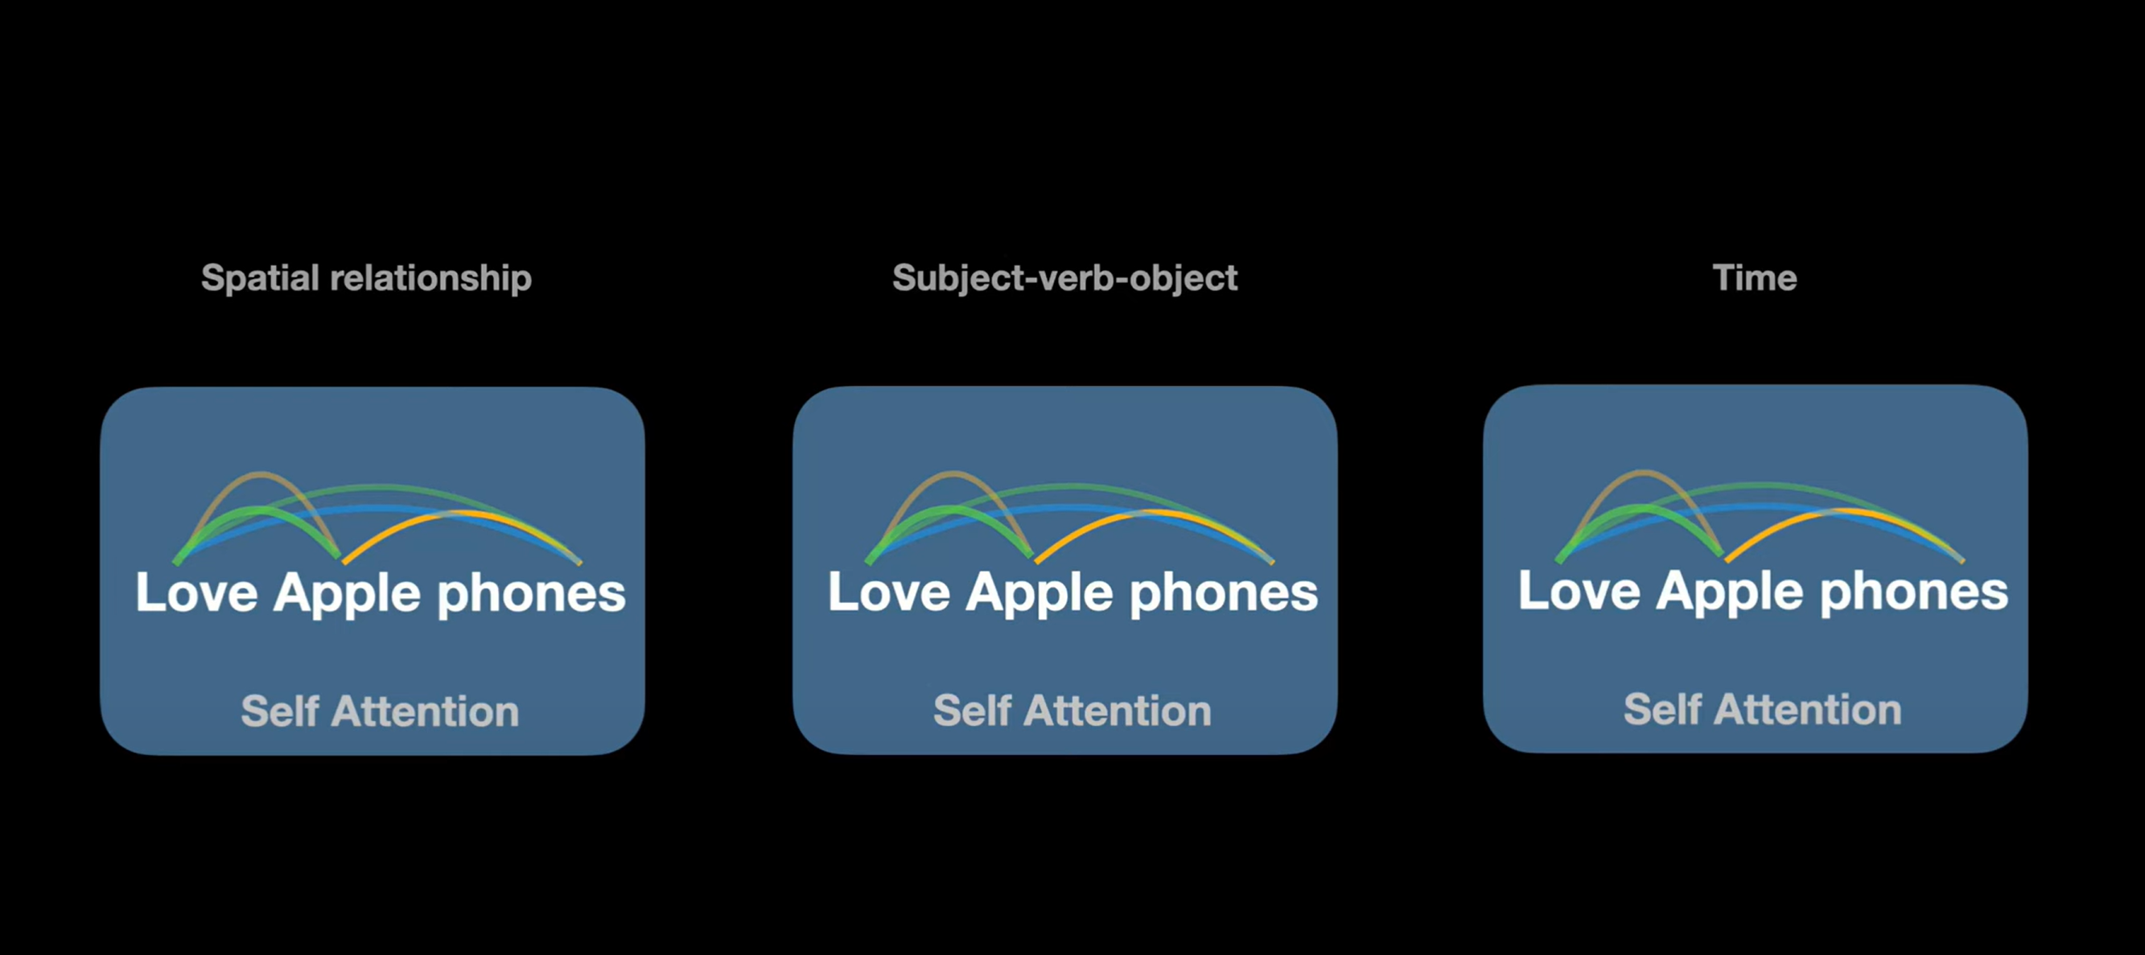

Slide 35
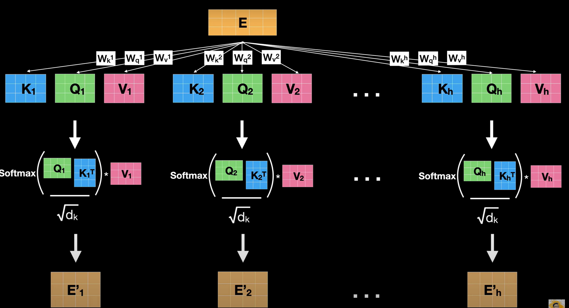

Slide 36
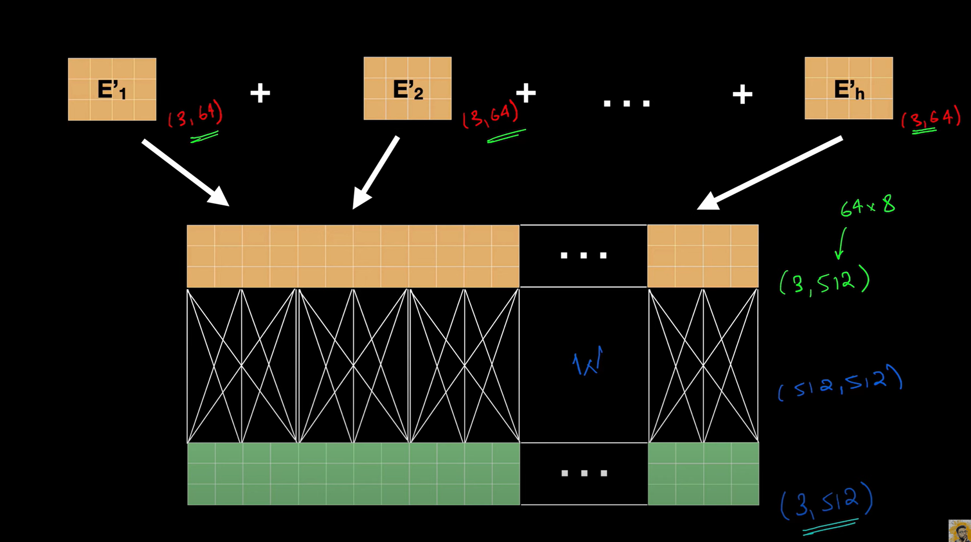

Slide 37
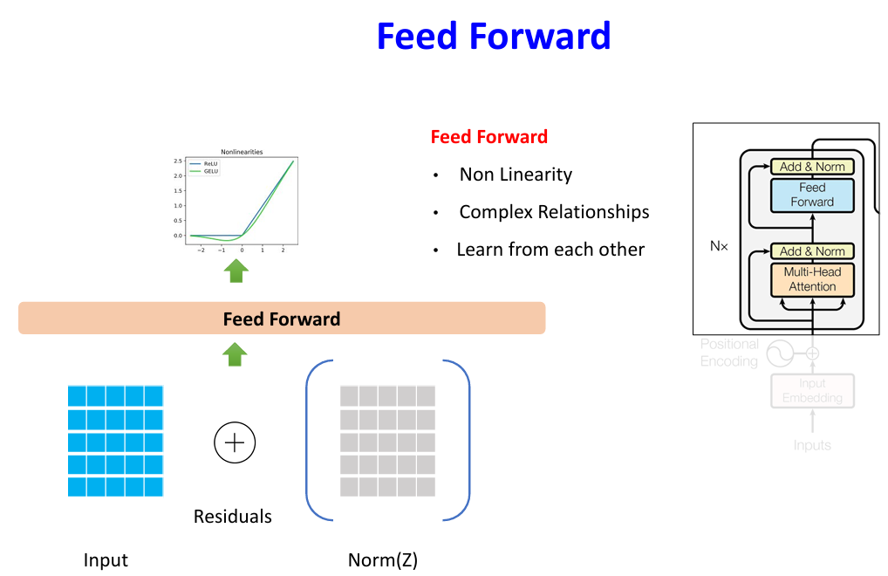

Slide 38
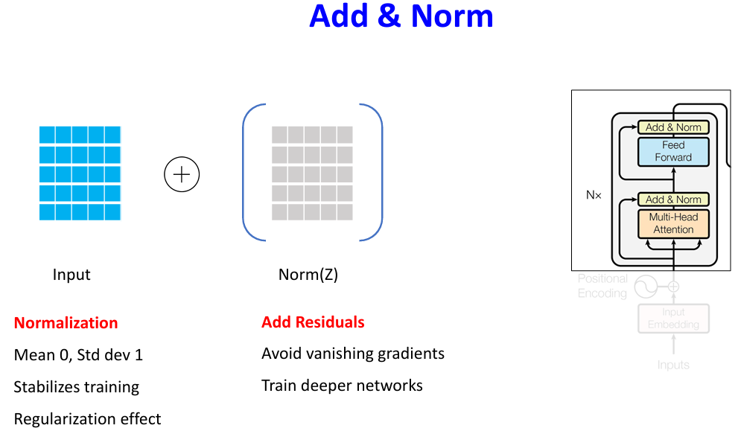

Slide 39
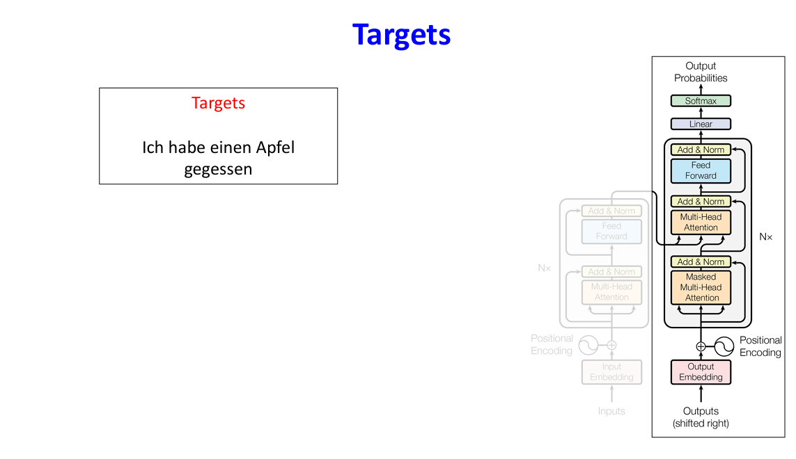
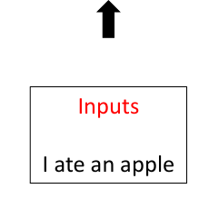

Slide 40
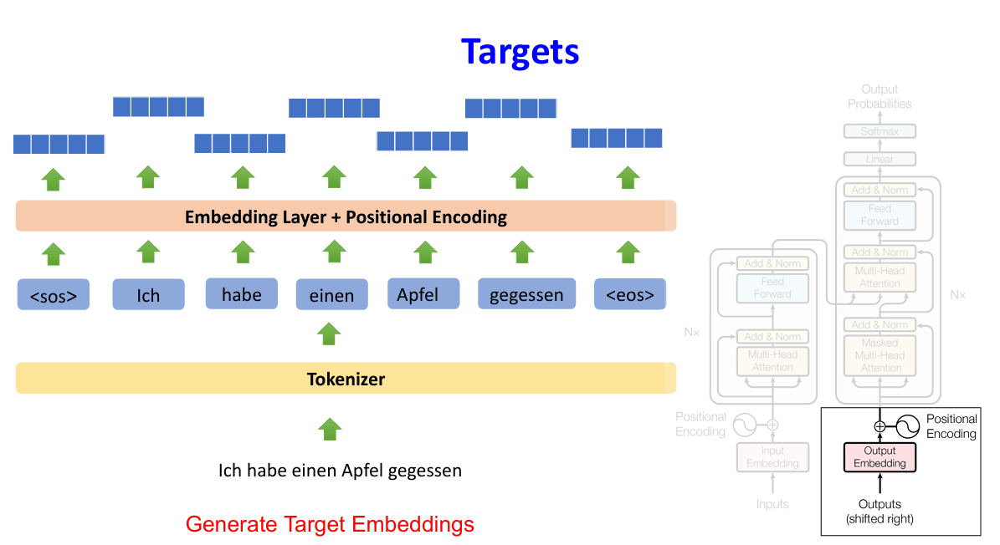

Slide 41
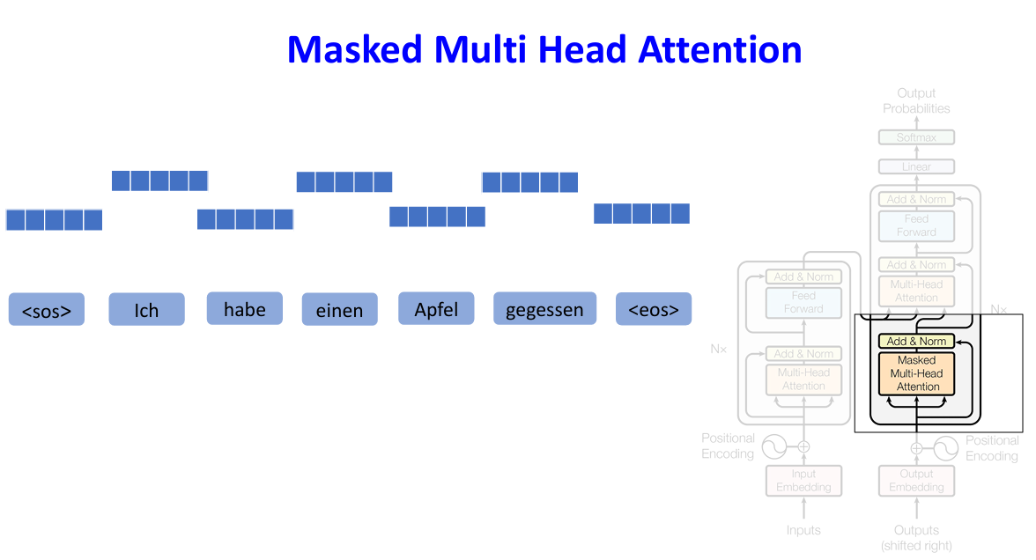

Slide 42
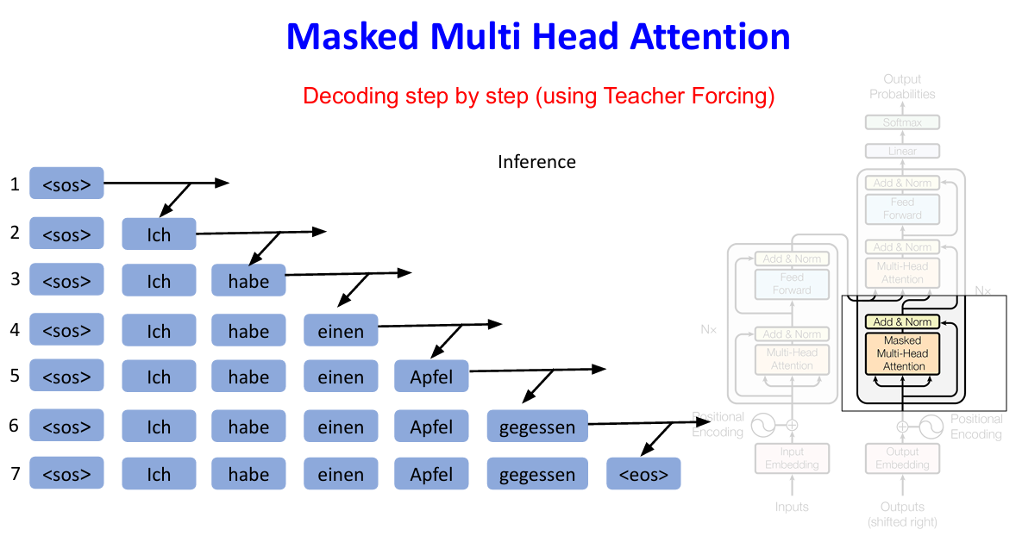

Slide 43
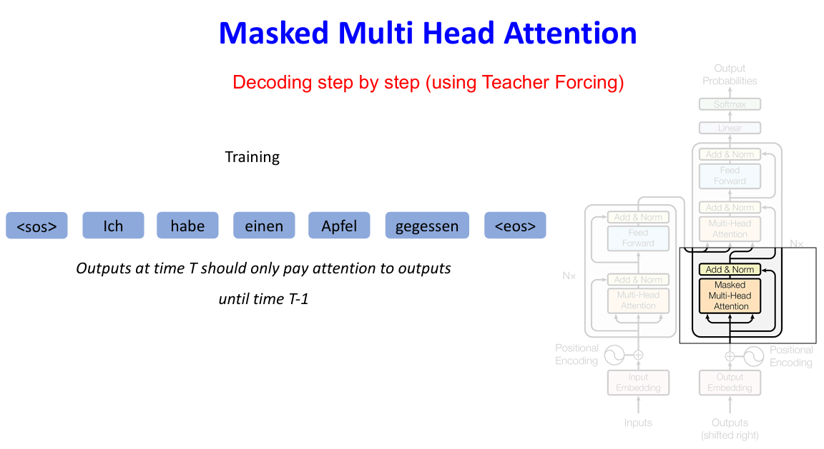

Slide 45
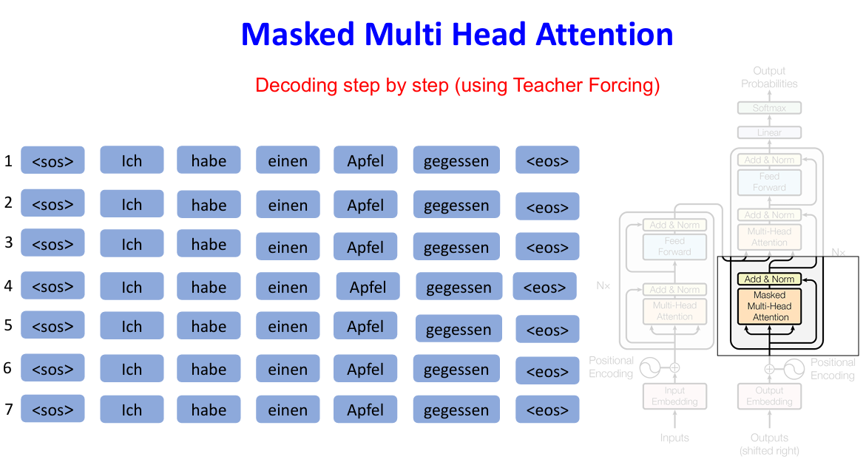

Slide 46


Slide 47


Slide 48


Slide 49


Slide 50


Slide 51


Slide 52


Slide 53


Slide 54


Slide 55


Slide 56



Slide 57


Slide 58






















Slide 59

























Slide 60











Slide 61











Slide 62
















Slide 63




Slide 64


























Slide 65








Slide 66


























Slide 67
















Slide 68














Slide 69

















Slide 70























Slide 71










Slide 72














Slide 73

U-Net Architecture

Slide 74



Slide 75


Slide 76


Slide 77


Slide 78


Slide 79


Slide 80


Slide 81


Slide 82
Denoising Diffusion Implicit Models (DDIMs)
Denoising Diffusion Implicit Models (DDIMs) are a deterministic variant of denoising diffusion probabilistic models (DDPMs), designed to generate high-quality data samples more efficiently. While DDPMs use a stochastic (random) process to reverse noise and recover data, DDIMs introduce a non-random, implicit sampling method that follows a deterministic path during inference. This significantly reduces the number of steps needed to generate realistic outputs, making the process faster without requiring changes to the training procedure. DDIMs still learn how noise is added to data during training, but during generation, they use that knowledge to progressively remove noise in a controlled manner, producing clean and coherent data samples with fewer iterations.

Slide 83


Slide 84


Slide 85
Latent diffusion model
LDMs don’t operate directly on pixels. Instead, they operate in a latent space (a compressed representation of the image).
So even if the original image is 256×256×3, the VAE encoder compress it to, say, 32×32×4 latent space (4 channels of latent features).

Slide 86

Latent diffusion model

Slide 87
Latent diffusion model
1. Autoencoder (VAE or VQGAN)
Purpose: Converts high-dimensional image data into a lower- dimensional latent space and vice versa.
a. Encoder
Compresses the input image (e.g. 256×256×3) into a latent representation (e.g. 32×32×4).
b. Decoder
Reconstructs the image from the latent representation.
Converts 32×32×4 back into 256×256×3.

Slide 88

Latent diffusion model

Slide 89

Latent diffusion model

Slide 90



Slide 91



Slide 92




Slide 93


HOW DO WE USE THESE DISTRIBUTIONS ?

Slide 94



Slide 95


Slide 96



Slide 97


Slide 98


Slide 99


Slide 100




Slide 101


Slide 102


Slide 103


Slide 104


Slide 105


Slide 106


Slide 107


Slide 108


Slide 109


Slide 110


Slide 111


Slide 112


Slide 113


Slide 114


Slide 115


Slide 116


Slide 117


Slide 118


Slide 119


Slide 120


Slide 121


Slide 122


Slide 123


Slide 124


Slide 125


Slide 126


Slide 127


Slide 128


Slide 129


Slide 130


Slide 131



Slide 132



Slide 133


Slide 134


Slide 135



Slide 136


Slide 137


Slide 138


Slide 139


Slide 140


Examples of intrinsic and extrinsic hallucination for a public LLM (access date: March 19, 2023). As an example of intrinsic hallucination, the LLM gives a conflicting judgment about the relationship between Cindy and Amy, which contradicts the input. For extrinsic hallucination, in this example, the LLM seems to have an incorrect understanding of the meaning of RLHF (reinforcement learning from human feedback), though it can correctly understand the meaning of LLMs (in this context).

Slide 141


Slide 142


Slide 143


Slide 144



